Slide 1
1
Graph theory: Introduction

Slide 2
Contents
Basic terminology,
Multi graphs and weighted graphs
Paths and circuits
Shortest path in weighted graph
Hamiltonian and Euler paths and circuits
Planer graph
Travelling salesman problem.

Slide 3
Introduction to Graphs
Definition: A graph is collection of points called vertices & collection of lines called edges each of which joins either a pair of points or single points to itself.
Mathematically graph G is an ordered pair of (V, E)
Each edge e_{ij} is associated with an ordered pair of vertices (V_{i},V_{j}).

Slide 4
Introduction to Graphs
_{v1}
In Fig. G has graph 4 vertices namely
v1, v2, v3, v4& 7 edges
Namely e1, e2, e3, e4, e5, e6, e7 Then e1=(v1, v2)
Similarly for other edges.
In short, we can represent G=(V,E) where V=(v1, v2, v3, v4) & E=(e1, e2, e3, e4, e5, e6,e7 )
e1
e2
_{v2}
_{v4}
e3
e5
e4
_{v3}
e7
e6
Graph G

Slide 5
Self Loops & Parallel Edges
Definition: If the end vertices V_{i} & V_{j} of any edge e_{ij} are same, then edge eij called as Self Loop.
For Example, In graph G, the edge e₆ =(v₃, v₃) is self loop.
Definition: If there are more than one edge is associated with given pair of vertices then those edge called as Parallel or Multiple edge.
For Example, In graph G, e₄ & e₇ has (v₃, v₄) are called as Parallel edge.

Slide 6
Simple & Multiple Graphs
Definition: A graph that has neither self loops or parallel edge is called as Simple Graph otherwise it is called as Multiple Graph.
For Example,
G1 (Simple Graph ) G2 (Multiple Graph)

Slide 7
Weighted Graph
Definition: If each edge or each vertex or both are associated with some +ve no. then the graph is called as Weighted Graph
For Example,
_{1.4}
_{V1}
_{V2}
₆
_{1.5}
_{V4}
_{V3}
_{1.7}

Slide 8
Finite & Infinite Graph
Definition: A graph is Finite no. of vertices as well as finite no. of edges called as Finite Graph otherwise it is Infinite Graph.
For Example, The graph G1 & G2 is Finite Graph.
Definition: A graph G=(V,E) is called as Labeled Graph if its edges are labeled with some names or data.
For Example, Graph G is labeled graph.

Slide 9
Adjacency & Incidence
Definition: Two vertices v₁ & v₂ vertices of G joins directly by at least one edge then there vertices called Adjacent Vertices.
For Example, In Graph G, v₁ & v₂ are adjacent vertices.
Definition: If V_{i} is end vertex of edge e_{ij}=(v_{i},v_{j}) then edge e_{ij} is said to be Incident on v_{i}. Similarly e_{ij} is said to be Incident on v_{j}.
For Example, In Graph G, e₁ is incident on v₁ & v₂.

Slide 10
Degree of a Vertex
Definition: The no. of edges incident on a vertex v_{i} with self loop counted twice is called as degree of vertex vi.
For Example, Consider the Graph G, d(v₁)=3 ,d(v₂)=2 ,d(v₃)=5 ,d(v₄)= 4
Definition :
A vertex with degree zero is called as Isolated Vertex & A vertex with degree one is called as Pendant Vertex.
_{v1}
e1
e2
_{v2}
_{v4}
e3
e5
e4
_{v3}
e7
e6

Slide 11
Handshaking Lemma
Theorem: The graph G with e no. of edges & n no. of vertices, since each edge contributes two degree, the sum of the degrees of all vertices in G is twice no. of edges in G.
i.e. ∑ d(v_{i})=2e is called as Handshaking Lemma.
Example: How many edges are there in a graph with 10 vertices, each of degree 6? Solution: The sum of the degrees of the vertices is 6*10 = 60. According to the Handshaking Theorem, it follows that 2e = 60, so there are 30 edges.
_{i=1}
_{n}

Slide 12
Matrix Representation of Graphs
A graph can also be represented by matrix.
Two ways are used for matrix representation of graph are given as follows,
Adjacent Matrix
Incident Matrix
Lets see one by one…

Slide 13
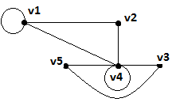
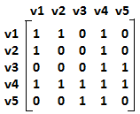
1. Adjacent Matrix
The A.M. of Graph G with n vertices & no parallel edges is a symmetric binary matrix A(G)=[a_{ij}] or order n*n where,
a_{ij}=1, if there is as edge between vi &vj.
a_{ij}=0, if v_{i} & v_{j} are not adjacent.
A self loop at vertex vi corresponds to a_{ij}=1.
For Example,
A(G)=

Slide 14
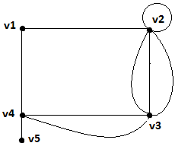
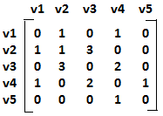
1. Adjacent Matrix
The A.M. of multigraph G with n vertices is an n*n matrix A(G)=[a_{ij}] where,
a_{ij}=N, if there one or more edge are there between v_{i} &v_{j} & N is no. of edges between v_{i} & v_{j}.
a_{ij}=0, otherwise.
For Example,
A(G)=

Slide 15
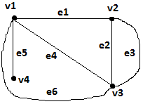
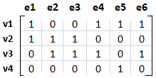
2. Incident Matrix
Given a graph G with n vertices , e edges & no self loops. The incidence matrix x(G)=[X_{ij}] of the other graph G is an n*e matrix where,
X_{ij}=1, if j^{th} edge e_{j} is incident on i^{th} vertex v_{i},
X_{ij}=0, otherwise.
Here n vertices are rows & e edges are columns.
X(G)=

Slide 16
Directed Graph or Diagraph
Definition: If each edge of the graph G has a direction then graph called as diagraph.
In a graph with directed edges, the in-degree of a vertex v, denoted by deg⁻(v) & out-degree of v, denoted by deg⁺(v).
See the example in Next page….

Slide 17
Directed Graph or Diagraph
Example: What are the in-degrees and out-degrees of the vertices a, b, c, d in this graph:
deg⁻(a) = 1
deg⁺(a) = 2
deg⁻(b) = 4
deg⁺(b) = 2
a
b
deg⁻(d) = 2
deg⁺(d) = 1
deg⁻(c) = 0
deg⁺(c) = 2
d
c

Slide 18
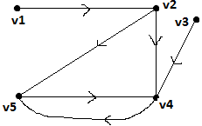
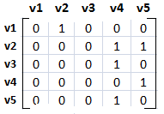
Adjacency Matrix of a diagraph
It is defined in similar fashion as it defined for undirected graph.
For Example,
A(D)=

Slide 19
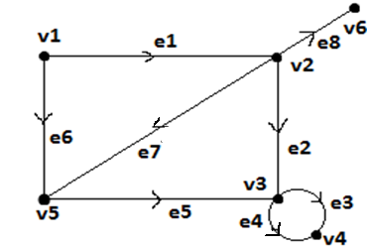
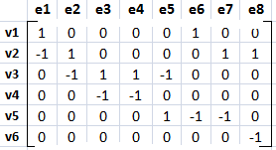
Incident matrix of diagraph
Given a graph G with n, e & no self loops is matrix x(G)=[X_{ij}] or order n*e where n vertices are rows & e edges are columns such that,X_{ij}=1, if jth edge e_{j} is incident out i^{th} vertex v_{i}
X_{ij}=-1, if jth edge e_{j} is incident into i^{th} vertex v_{i}
X_{ij}=0, if jth edge e_{j} not incident on i^{th} vertex v_{i}.

Slide 20
Null Graph
Definition: If the edge set of any graph with n vertices is an empty set, then the graph is known as null graph.
It is denoted by N_{n} For Example,
N₃ N₄

Slide 21
Complete Graph
Definition: Let G be simple graph on n vertices. If the degree of each vertex is (n-1) then the graph is called as complete graph.
Complete graph on n vertices, it is denoted by K_{n}.
In complete graph K_{n}, the number of edges are
n(n-1)/2,For example,
K₁
K₂
K₃
K₄
K₅

Slide 22
Regular Graph
Definition: If the degree of each vertex is same say ‘r’ in any graph G then the graph is said to be a regular graph of degree r.
For example,
K₃
K₄
K₅

Slide 23
Bipartite Graph
Definition: The graph is called as bipartite graph , if its vertex set V can be partitioned into two distinct subset say V1 & V2. such that V1 U V2=V & V1 ∩ V2 = ∅ & also each edge of G joins a vertex of V1 to vertex of V2.
A graph can not have self loop.

Slide 24
Bipartite Graphs
Example I: Is G1 bipartite?
v₁
No, because there is no way to partition the vertices into two sets so that there are no edges with both endpoints in the same set.
v₂
v₃
Example II: Is G2 bipartite?
v₁
v₁
v₆
v₆
Yes, because we can display G2 like this:
v₂
v₅
v₂
v₅
v₃
v₄
v₃
v₄

Slide 25
Isomorphism
Definition: Two graphs are thought of as equivalent (called isomorphic) if they have identical behavior in terms of graph theoretic properties.
Two graphs G(V, E) & G’(V’,E’) are said to be isomorphic to each other if there is one-one correspondence between their vertices & between their edges such that incidence relationship in preserved.
It is denoted by G1=G2

Slide 26
Isomorphism
For Example,
1 2 a b
4 3 d c
It is immediately apparent by definition of isomorphism that two isomorphic graphs must have,
the same number of vertices,
the same number of edges, and
the same degrees of vertices.
1
a
2
b
3
d
4
c

Slide 27
Sub Graph
Definition: A sub graph of a graph G = (V, E) is a graph G’ = (V’, E’) where V’⊆V and E’⊆E.
For Example:
G G1 G2

Slide 28
Spanning Graph
Definition: Let G=(V, E) be any graph. Then G’ is said to be the spanning subgraph of the graph G if its vertex set V’ is equal to vertex set V of G.
For Example:
G G1 G2

Slide 29
Complement of a Graph
Definition: Let G is a simple graph. Then complement of G denoted by ~G is graph whose vertex set is same as vertex set of G & in which two vertices are adjacent if & only if they are not adjacent in G.For Example:
G ~G H ~H

Slide 30
Operations on Graphs
Definition: The union of two simple graphs G₁ =
(V₁, E₁) and G₂ = (V₂, E₂) is the simple graph with vertex set V₁ ∪ V₂ and edge set E₁ ∪ E₂.
The union of G₁ and G₂ is denoted by G₁ ∪ G₂.
G₁
G₂
G₁ ∪ G₂

Slide 31
Operations on Graphs
Definition: The Intersection of two simple graphs G₁ =(V₁, E₁) and G₂ = (V₂, E₂) is the simple graph with vertex set V₁ ∩ V₂ and edge set E₁ ∩ E₂.
The Intersection of G₁ and G₂ is denoted by G₁ ∩ G₂.
G₁
G₂
G₁ ∩ G₂

Slide 32
THANKING YOU KEEP READING

